Slide 1
Eco Lifestyle Agent
IBM AICTE PROJECT
Presented By:
Student name : Shrama V Shetty
College Name & Department : St Joseph Engineering College Vamanjoor, Mangalore & Computer science engineering

Slide 2
OUTLINE
Problem Statement
Technology used
IBM cloud services used
Wow factor
End users
Result
Conclusion
Git-hub Link
Future scope
IBM Certifications

Slide 3
Problem Statement
Many individuals lack easy access to personalized, trustworthy information on sustainable living practices. Manually searching for eco-friendly tips, local recycling guidelines, and green alternatives is time-consuming and often overwhelming.
Proposed Solution:
An Eco Lifestyle Agent, powered by RAG (Retrieval-Augmented Generation), empowers users to adopt a greener lifestyle through personalized, practical suggestions. It retrieves sustainable living tips, eco-friendly product recommendations, local recycling guidelines, and government schemes from trusted environmental sources

Slide 4
Technology used
IBM cloud lite services
Natural Language Processing (NLP)
Retrieval Augmented Generation (RAG)
IBM Granite model
TOOLS USED
Word
Github

Slide 5
IBM cloud services used
IBM Cloud Watsonx AI Studio
IBM Cloud Watsonx AI runtime
IBM Cloud Agent Lab
IBM Granite foundation model

Slide 6
Wow factors
This agent encourages sustainable living through personalized, AI-powered suggestions, making eco-
friendly habits more accessible and actionable for everyone.
Unique Features:
Delivers real-time green living tips using RAG and IBM Granite
Provides eco-friendly alternatives for daily use products
Retrieves document-backed information like recycling rules and green schemes
Responds to natural language queries .
Promotes awareness of sustainability policies and government programs
It provides information about local recycling and waste management based on the user’s city.
It contains sample questions which user can use to ask questions.

Slide 7
End users
Environment-conscious individuals
Use the agent to get daily, personalized tips for living eco friendly lifestyle.
2. Students and educators
Benefit from the agent as a learning tool to understand sustainability concepts and practices.
3. NGOs and community organizations
Use the agent to spread environmental awareness and guide communities with accurate green information.
4. Smart city planners or local authorities
Use the agent to provide localized recycling rules and eco-guidance to urban citizens.
5.Green product companies
Can be used as an educational tool to promote eco-friendly alternatives to consumers.

Slide 8
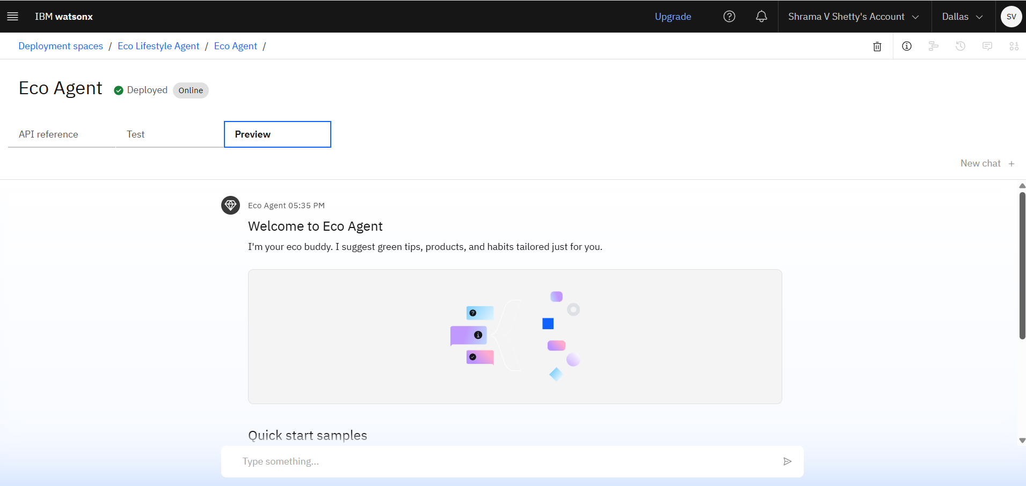
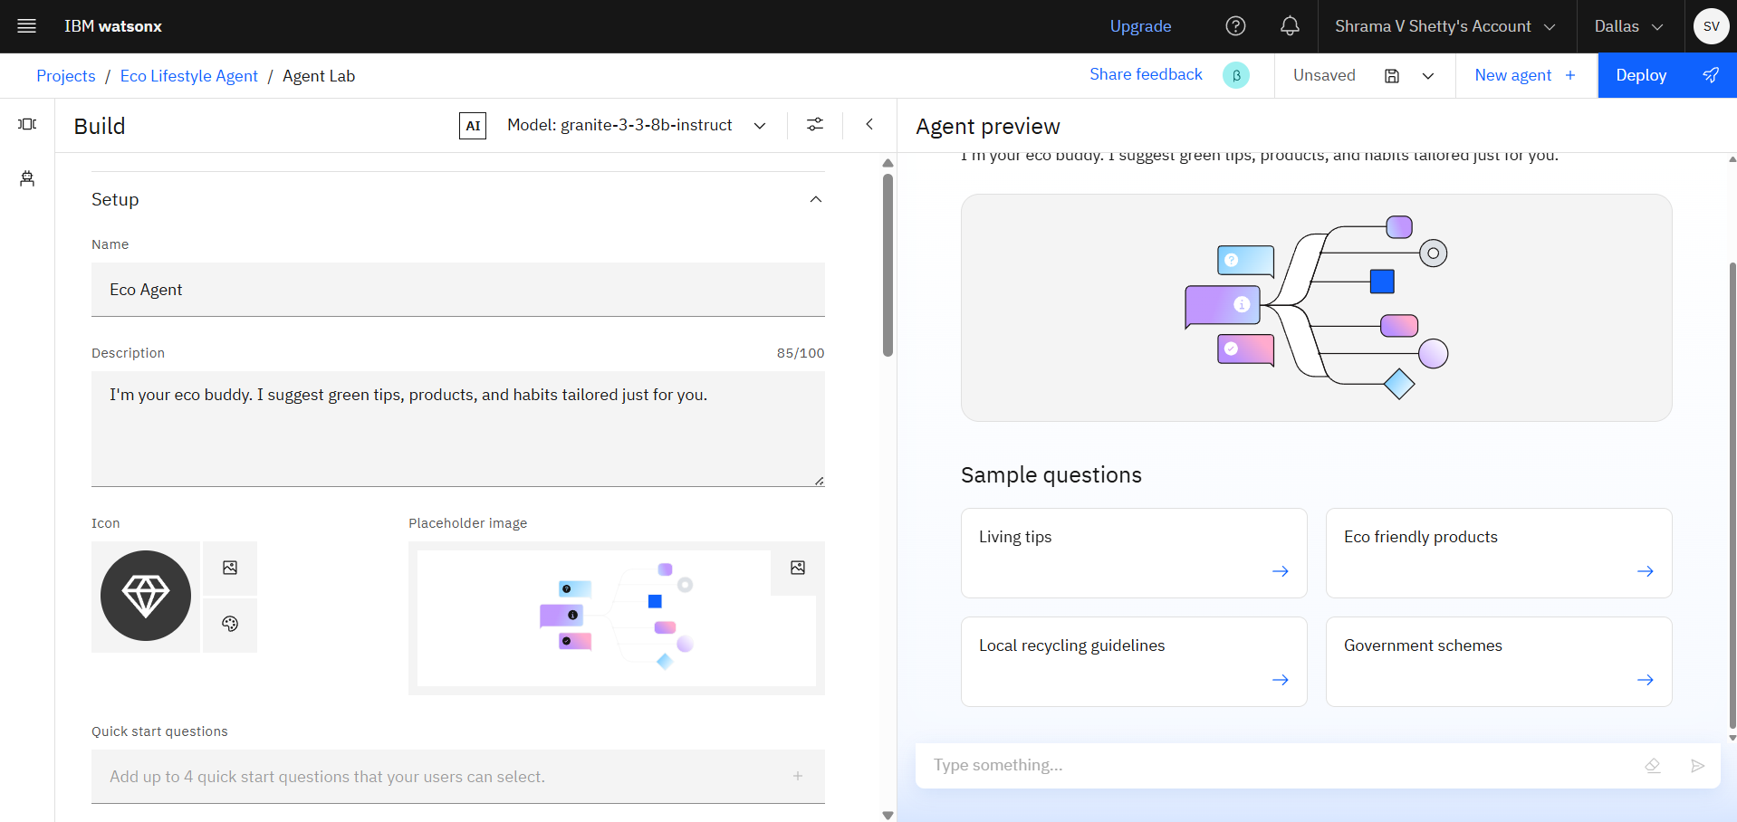
Results
Deployed Eco Agent
Eco Agent with Sample questions . Here user can click on the question and the agent will answer the question. Here the user need not type the question.

Slide 9
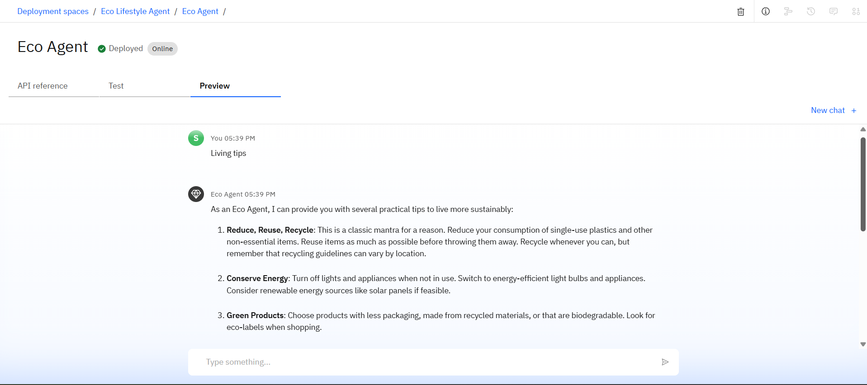
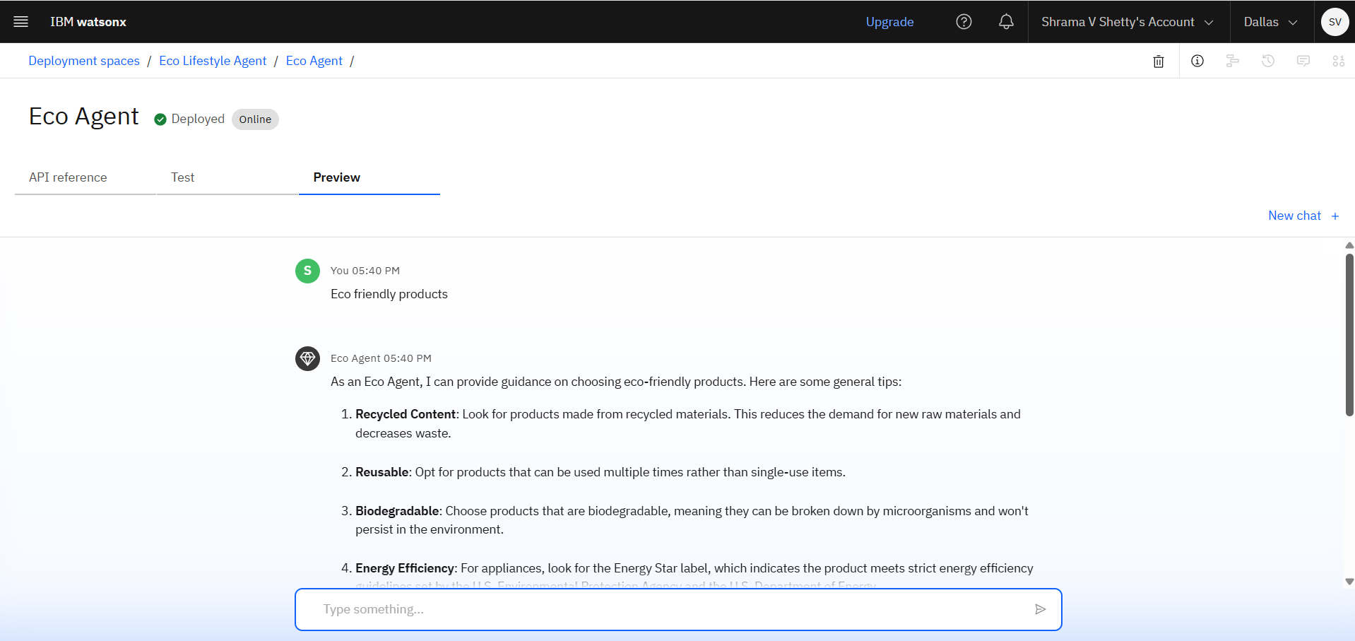
Results
This is the answer given by agent when user selected the sample query

Slide 10
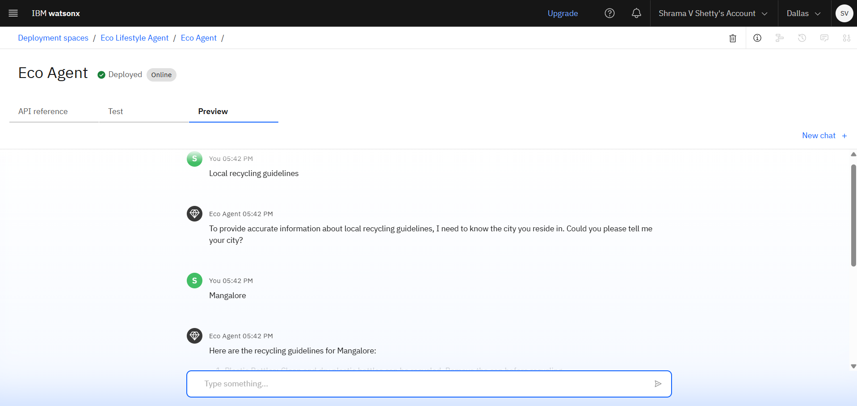
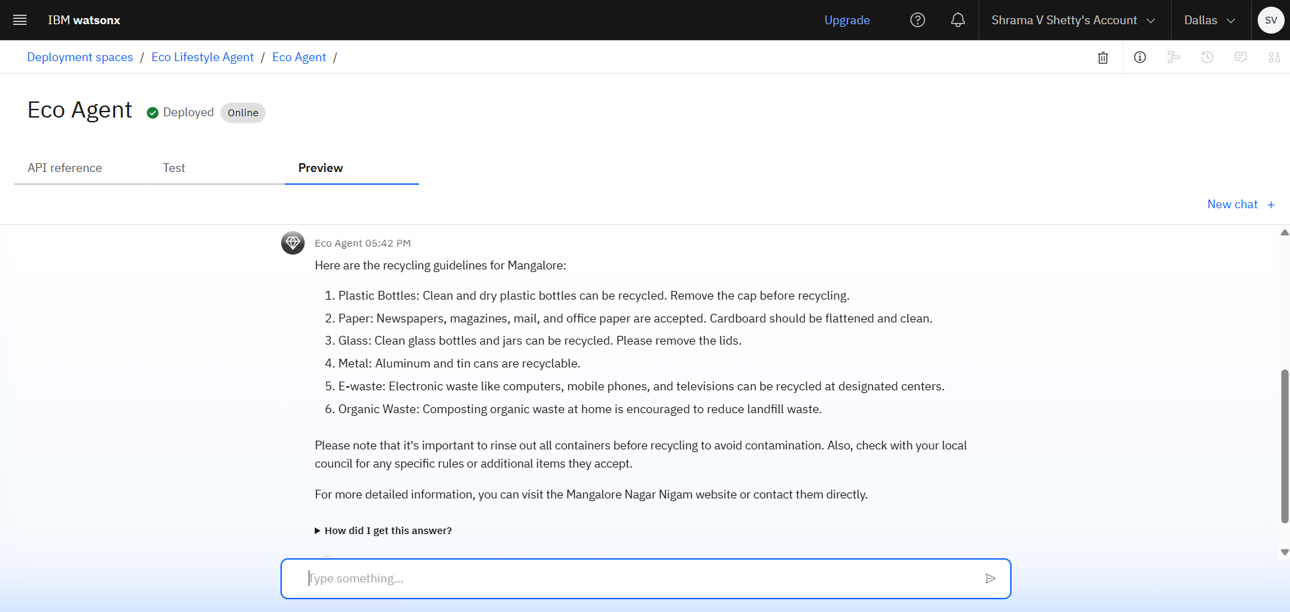
RESULTS
When the user select local recycling guidelines ,agent request the city name and customizes the response according to the city

Slide 11
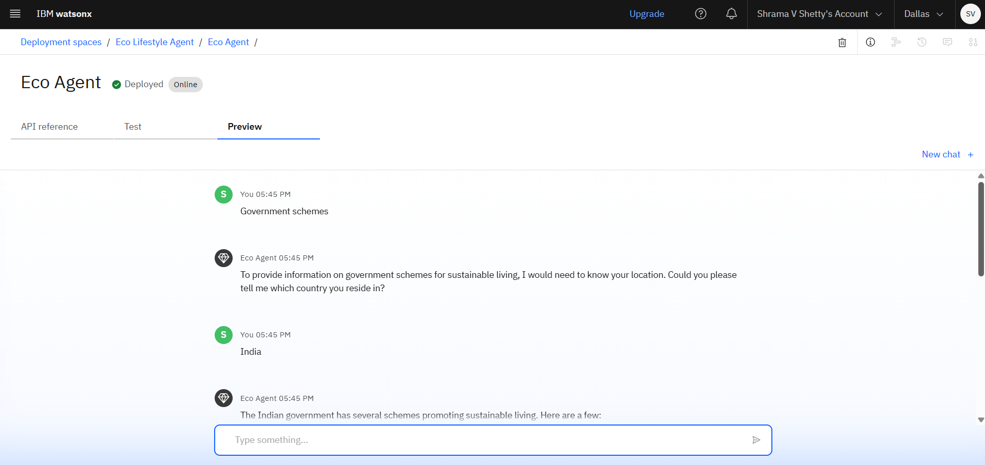
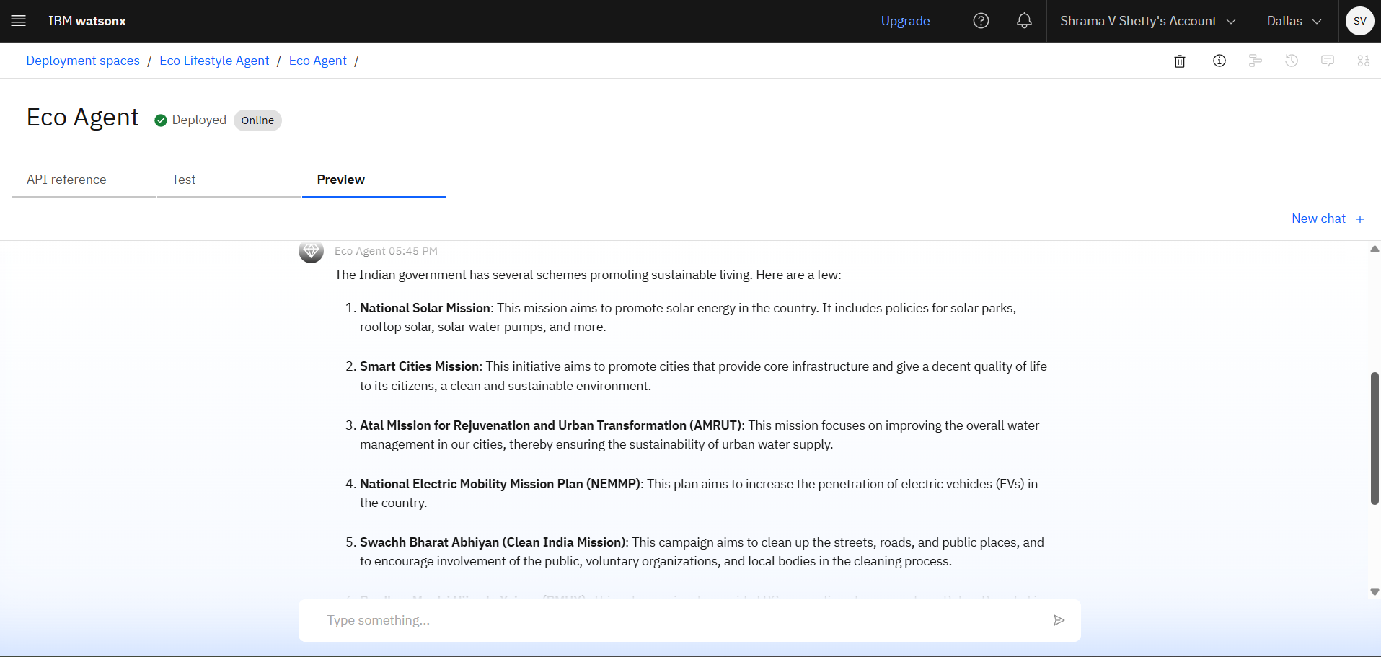
RESULTS
When the user select Government schemes ,agent request the country name and customizes the response according to the country

Slide 12
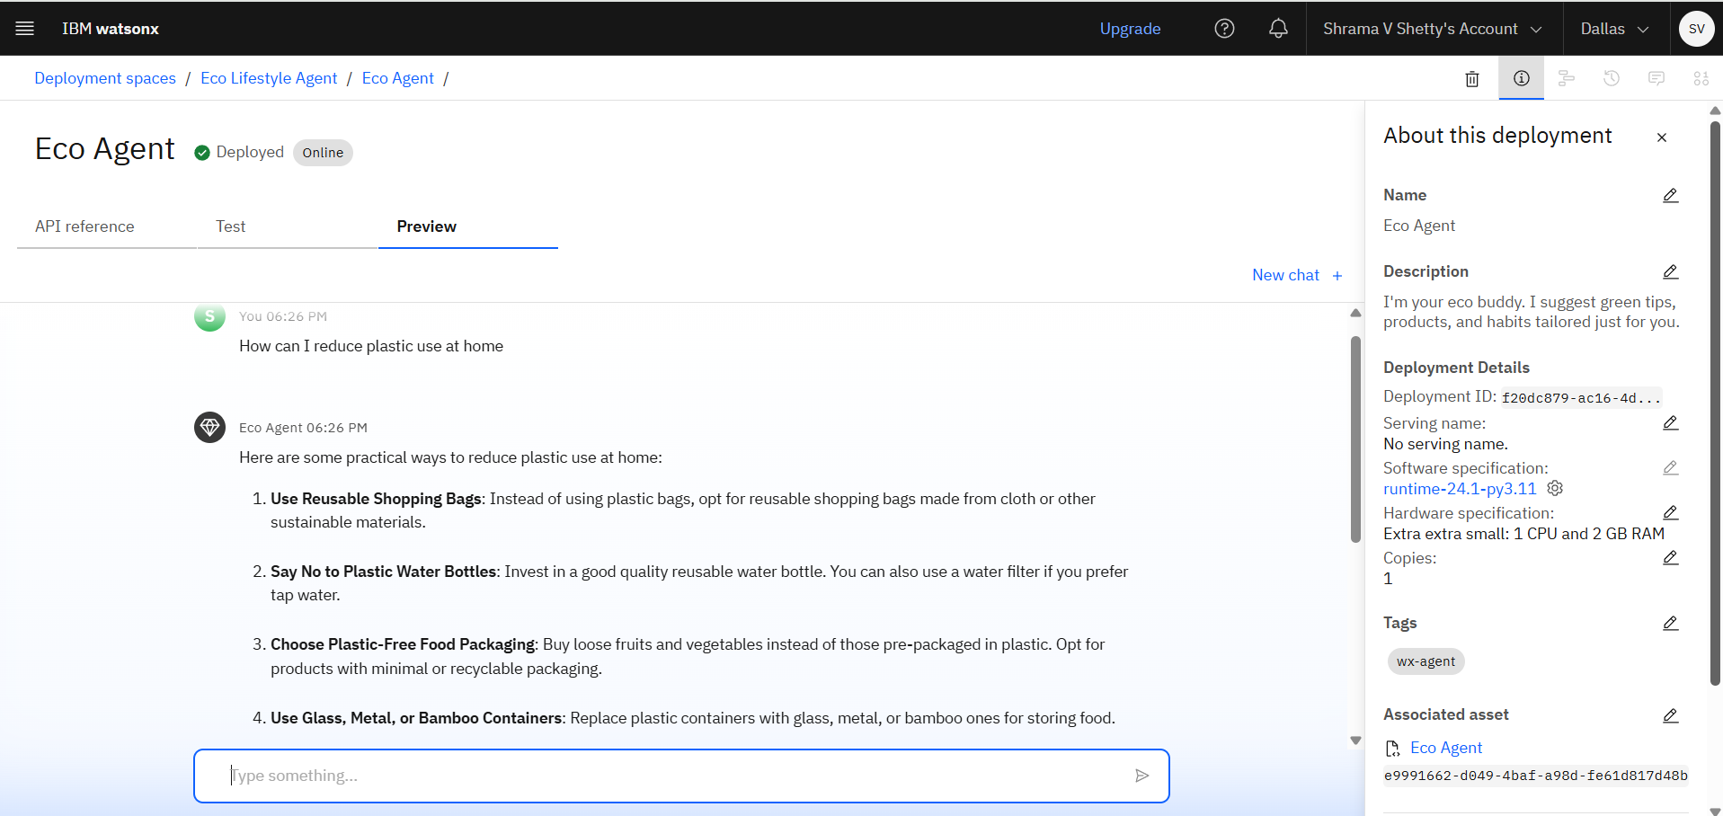
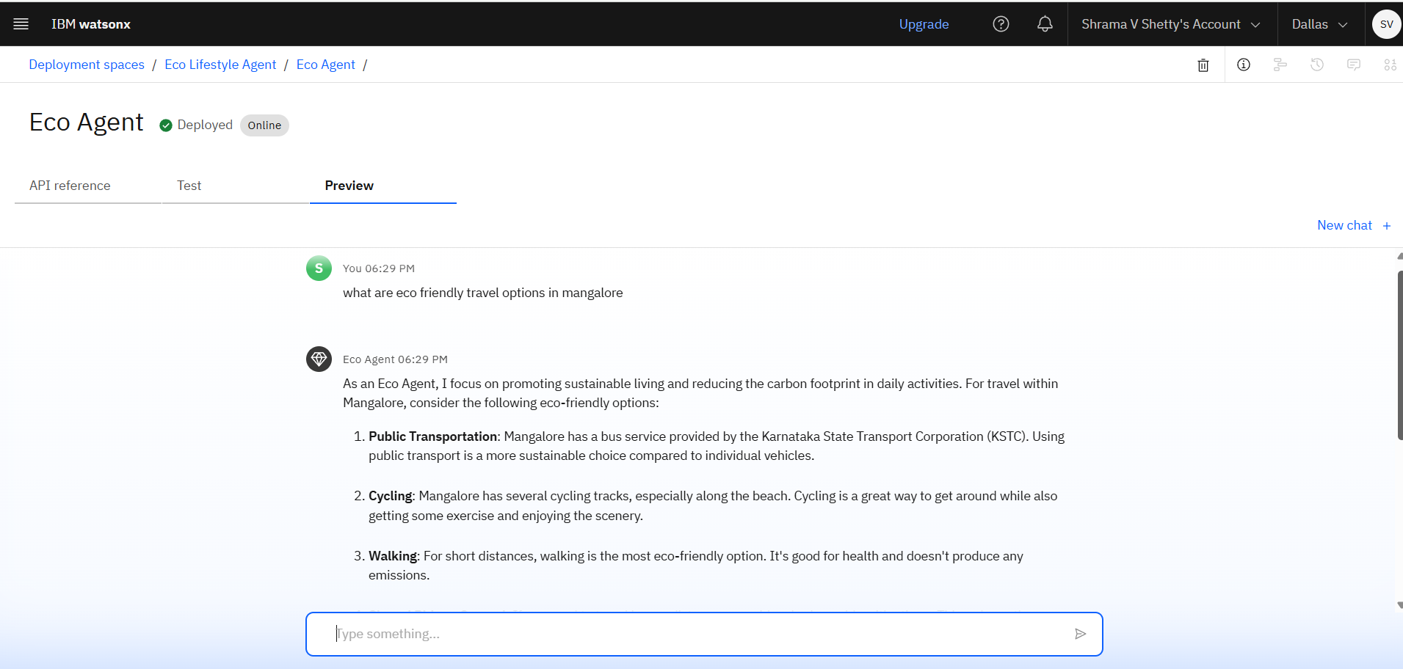
RESULTS
Agent answer to the questions asked by user

Slide 13
Conclusion
Eco Agent makes sustainability more accessible and actionable
Empowers users to take green actions every day
Demonstrates the power of RAG + IBM Granite in real-world AI solutions
Bridges the gap between sustainability knowledge and everyday behavior

Slide 14
Future scope
Support for regional languages (multilingual interaction)
Integration with smart home devices (e.g., voice assistants)
Daily eco-tips via WhatsApp or chatbot
Connect with local eco-product sellers and NGOs
Track user's carbon footprint and habit progress

Slide 15
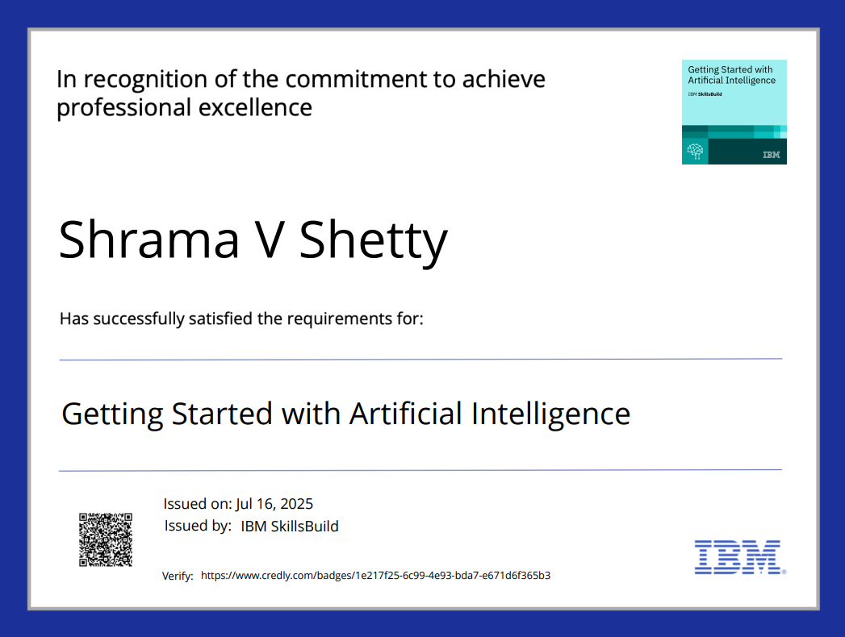
IBM Certifications

Slide 16
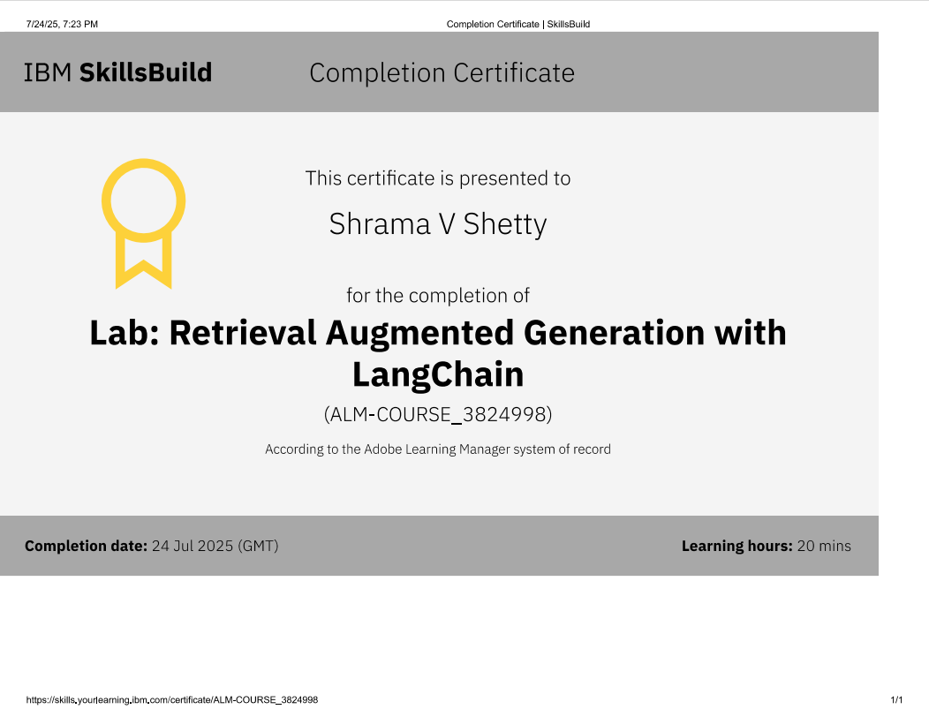

Slide 17
GitHub Link
github link: https://github.com/Shrama-v-shetty/Eco-lifestyle-agent

Slide 18
THANK YOU

